Slide 1
Music Library
29-03-2025

Slide 2
Current status
Library can be imported from Traktor collection file
BarcodesIDs are generated from UUID value of playlist
Barcodes are generated from a general type identifier + barcodeIDs
Library cannot be modified and we cannot write to a collection file yet
Test shows that it is possible to modify collection file, and Traktor behaves accordingly

Slide 3
Whishes
Ability to add tracks to playlists
Easy to search tracks
Ability to add new playlists?

Slide 4
Suggested solutions
We could allready make a list of unassigned UUIDs, and print the associated barcodes
If we whish to make a new playlist, we can scan such a barcode and give it a name, and location in the tree
So we need some command like createPlaylist, and assignBarcode (could also be used to assign a barcode of an old deleted playlist to a new playlist)
Also make a command for searchTrack
Make a temporary playlist, which is easy to clear, for use during a set; make a to delete playlist, in order to see which tracks I need to remove from collection
Loading tracks to a playlist
Using shift+load we enable backloading tracks from the deck to the prelistenDeck
Using a button on the launchpad, we allow adding a track to a playlist
Keep this button pressed, then scan playlist
If shift button is specific to each deck (or we can store active deck), then we can also allow to directly add to playlist by shift + scan;
We also need to check our system for storing and retrieving the library, how, and when is this done? And we need to be able to adapt the Traktor collection file (maybe we can reconstruct it from scratch?)

Slide 5
Temporary solution
Modifying the traktor collection file takes quite some time to implement
Make a list of nameless playlist with UUIDs and print associated barcodes
We allready have custom playlists in place; we need to disconnect name and UUID
Need to make it easy to change the name of the playlist
Need to distinguish between special and custom playlists
Special: automatically generated: E1, E2, etc; session playlist
Custom: stored and retrieved, songs added by user
Added manually

Slide 6
Custom playlists
UUID | Name
1e0f57a1b3d24d0cbd5e6ffb5e37359f
3e4fdbaedb7a4087bbd6a67c276a1b89
d1b663b69d374d91b7a59a7bce27413b
33d1c4e9c937404086768998f384e44f
0ceffb32db8048b4b51f8301b70f296e
fc4cb05b5da442e983019388a2b8e3c5
7eb4c269c3644c0ba1bfe2a62a57db9f
4173cbf5574f4b92827a2d51e7b7d6ed
1e256130a8ff43c8844a8d3d56f37a71
dcbe7e16fbc54a88b6a29339bfcaf0d9
5e180153c08445f7bff4f81c157f3de7
a3a0df06dbd54069ae2380045b5eb6d4
f0f86c15c3a940e9a3c93b4a66d3f37d
e0f01e9a67c04b54a9fc40442909a126
e2178794fa8b43b2a14c0709b4aa4b46
f3fc5d2e0f4e47018f8c79c3be85f9aa
a559f9023a024249a498249407013a32
84ad0adfb49f4185a77a81697a3ea12d
90a8367b0d164a57806b171ed05f2da8
23963e325e4147d2bd8cfce8323d2e88
I generated them with ChatGPT, and checked if they are unique using
~musicLibrary.playlists.leafDo({|path, item| if(~newUUIDs.includes(item.uuId)){item.name.postln}});

Slide 7
Problem with custom playlists
Currently I store the indexes of tracks
If I create my own playlist within supercollider, it’s not sufficient to only write down the index, since the index might change
Solution: use a dictionary, with as key the id value of the track

Slide 8
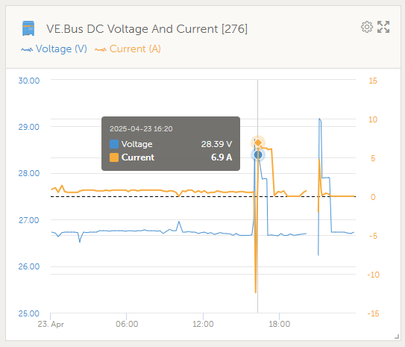
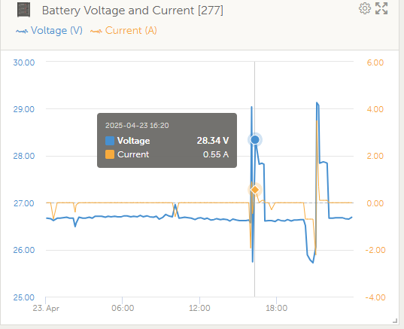
Weird descrapency between shunt and multi

Slide 9
Lists of songs
Dictionary, for library purposes
Array of ids, for playlists, ids need to be looked up in track dictionary
Array of tracks, for playing and handling by library console

Slide 10
Duplicate songs
If I have a traktor library which includes the exact same song twice
Both have the same audio id
But different file location
When loading the library there will be made one entry, and this entry will be overriden with the other file location
Looking up playlists goes by file location
Better store them by file location instead of audio id in the dictionary

Slide 11
Todo
Fix Traktor analyzing
Download remaining songs
Make custom playlists
Test not-forced loading

